Slide 1


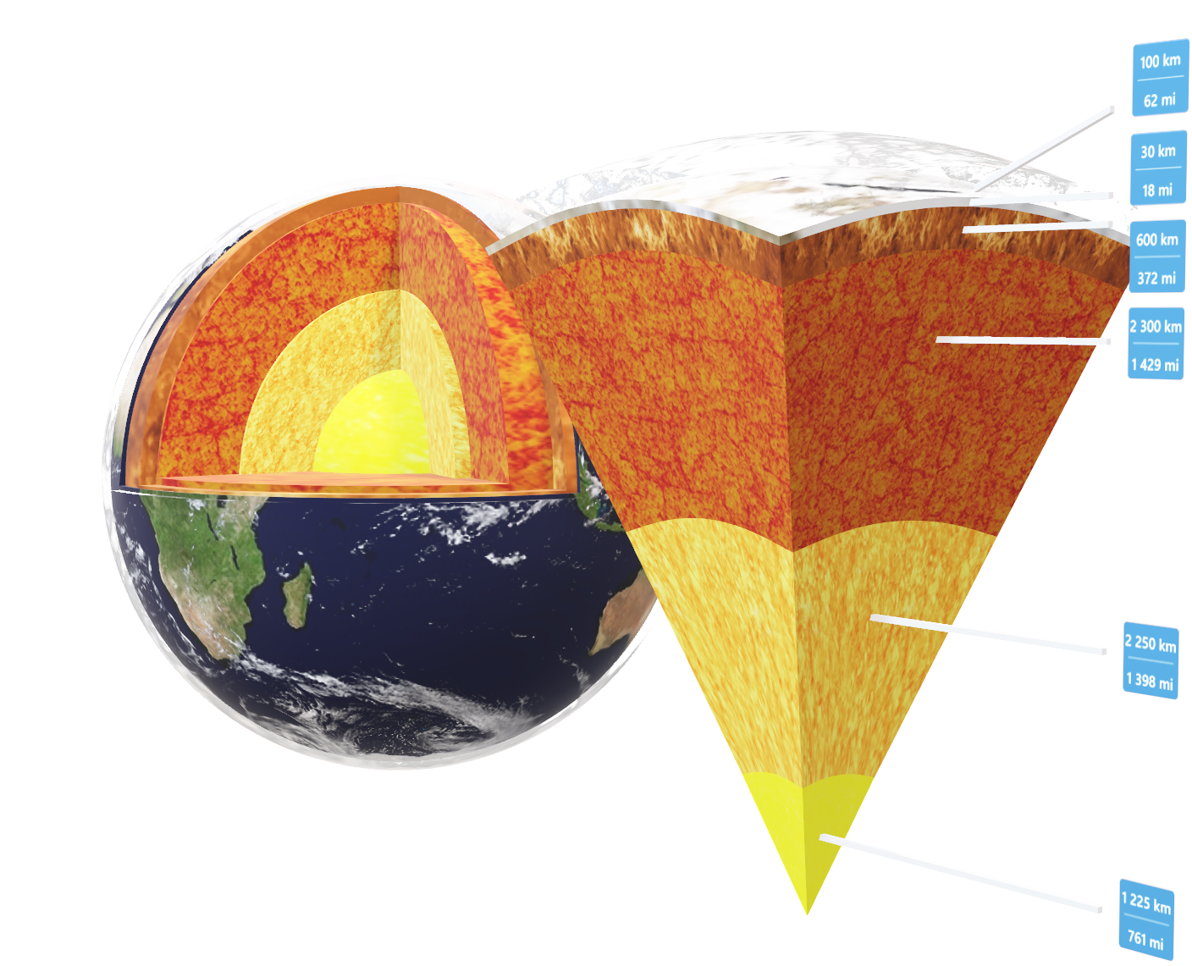
Duration: 65 min
High School
Grades: 9 - 12
CCSS, NGSS
Beneath the surface
Earth and Space Sciences, Geology
Click on the model to interact

Slide 2

Lesson overview
It may seem that earth’s only source of heat is the sun. That is partially true. The sun heats the earth only a few meters below the surface. Not far beneath the surface it gets hot again. The high temperatures below are a result of the heat produced by the planetary core. This heat is driven together with the melted solid matter to the upper part of the Earth’s mantle, where it gets into the lithosphere. At the same time other, old parts of it return to the mantle and so closes the rock cycle. The old rock is melted again and participates in the heat and matter transfer, called thermal convection.
Learning objectives
Keywords
Find out what is the Earth’s structure and describe its layers.
Understand what the lithosphere looks like and how the tectonic plates move.
Learn about the rock cycle and heat transfer from the planet’s core to the surface.
Earth, Core, Mantle, Lithosphere, Asthenosphere, Plates, Tectonics, Convergent Boundary, Divergent Boundary, Volcano, Magma, Rock, Cycle, Heat, Thermal Convection
Standards
Common Core CCSS ELA-Lit. SL.9-10.1
Initiate and participate eﬀectively in a range of collaborative discussions (one-on-one, in groups, and teacher-led) with diverse partners on grades 9–10 topics, texts, and issues, building on others’ ideas and expressing their own clearly and persuasively.
RHST.9-10.3
Follow precisely a complex multistep procedure when carrying out experiments, taking measurements, or performing technical tasks, attending to special cases or exceptions defined in the text.
RHST.9-10.4
Determine the meaning of symbols, key terms, and other domain-specific words and phrases as they are used in a specific scientific or technical context relevant to grades 9–10 texts and topics.
WHST.9-10.7
Conduct short as well as more sustained research projects to answer a question (including a selfgenerated question) or solve a problem; narrow or broaden the inquiry when appropriate; synthesize multiple sources on the subject, demonstrating understanding of the subject under investigation.
NGSS
HS-ESS2-3
Develop a model based on evidence of Earth’s interior to describe the cycling of matter by thermal convection.

Slide 3
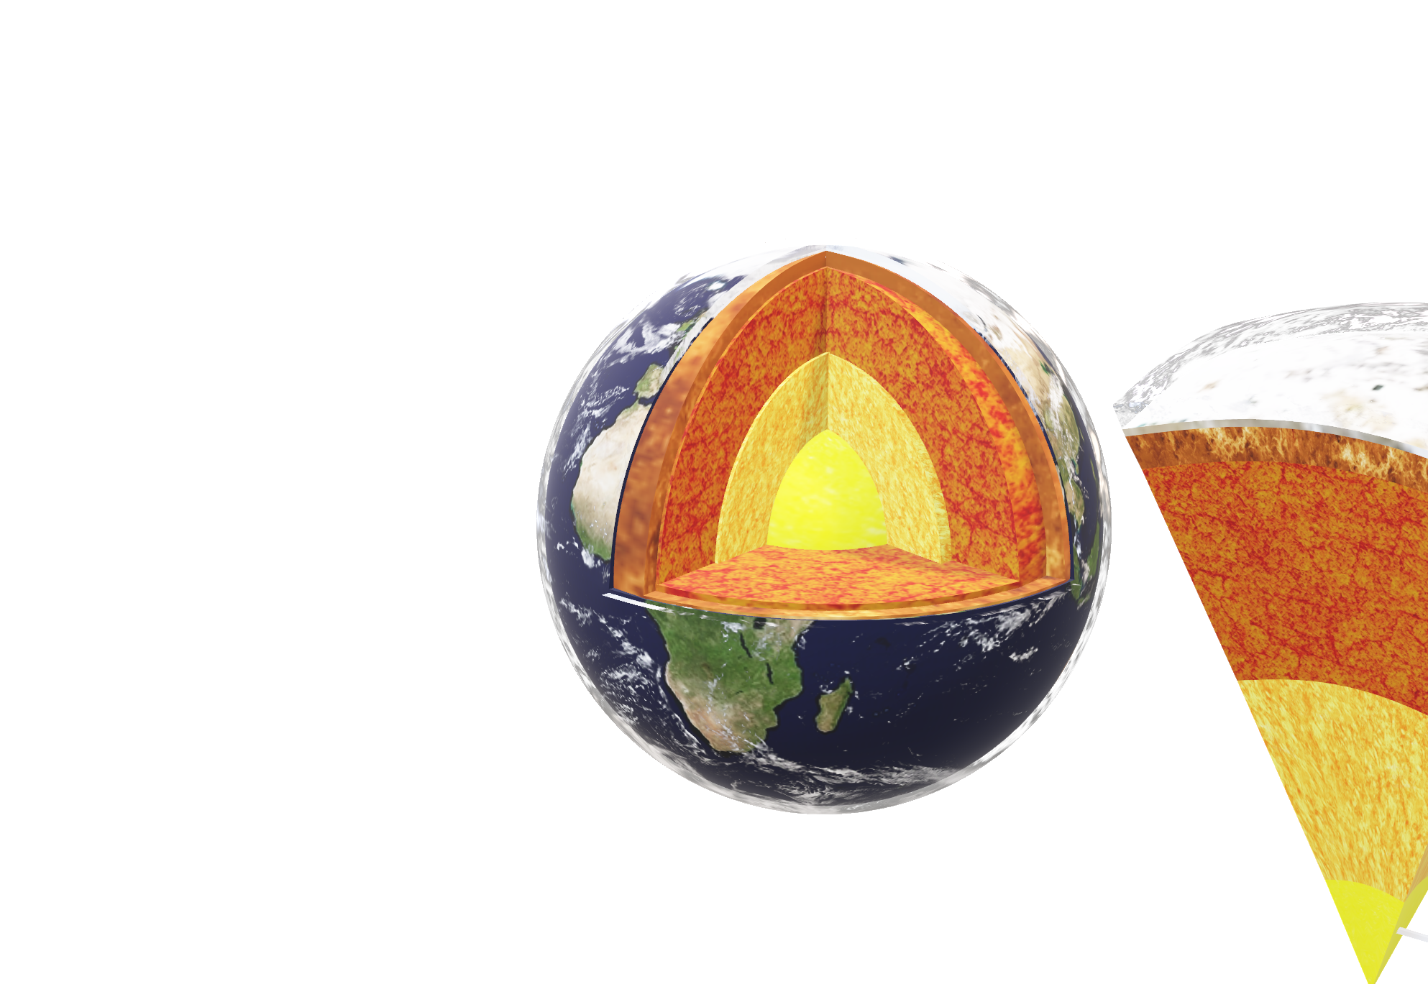
1. Introduction
5
min
Planet Earth is a very diverse place. On Earth we can find various forms of life. There is also a complicated internal structure. Thanks to this internal structure and the processes which occur influences the Earth’s surface, its atmosphere, climate and consequently all life forms. In the beginning of the lesson, do a brief brainstorming. Try to ask your students if they can think of what happens below our Earth’s surface and how these processes have influence on what happens above it.
2. Heating and cooling the materials
10
min
If we look at our Earth from space, it looks like a peaceful and calm planet. However, in the interior there is a lot of turmoil. Earth is made up of a variety of layers, divided by their chemical or physical properties. They are arranged like the skin of an onion. Have a look at the planet’s internal structure, using the Lifeliqe app. Open the “Earth“ model in the Astronomy gallery and click on the respective layers of the globe. To get a better idea about them, use also the V-cut version of this model or find the called “Structure of the Earth“ in the Geology gallery. Speak briefly about all Earth’s layers. Especially mention their chemical composition and physical conditions, explain the diﬀerence between the chemical and the mechanical division, etc.
Click on the model to interact

Slide 4
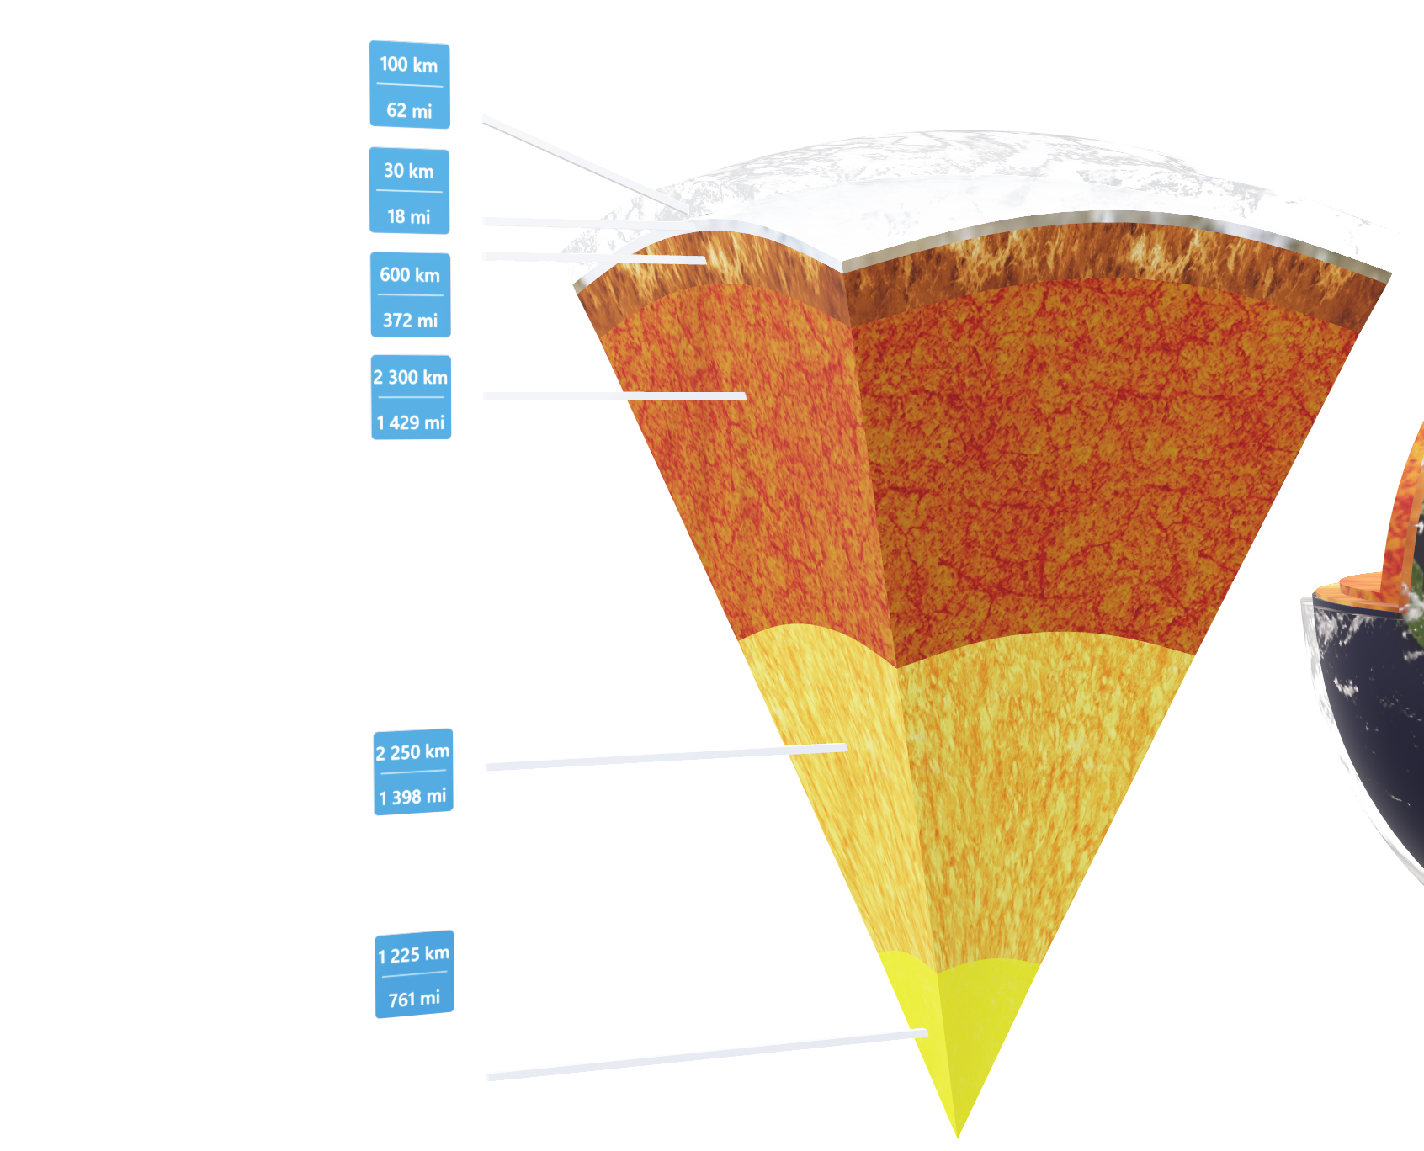
3. Heat from beneath
5
min
Speak about the Earth’s interior properties, it is important to say that because of its temperature, the Earth as a whole is a body of stored heat, which radiates into space. This is the result of three factors: first, because of the conserved heat from the planet’s creation, second, frictional heating, caused by the sinking of the denser core material to the center and finally, heat caused by the decay of radioactive elements that are present there.
The temperature decreases as we move further away from the Earth’s core. Finally, the surface of the planet or so called crust is cooled down to temperatures favourable to the presence of the life forms that live there. However, in comparison with the rest of the planet it’s just a very thin layer of rocks. But it interacts fundamentally with the layer which lies beneath of it, the so called upper mantle, namely with its superior part called asthenosphere.
The asthenosphere is highly viscous and deforming. As was said, it lies just beneath the lithosphere and there is a lot of heat and pressure, so the rocks there are less dense than those in the lithosphere. With a little bit of exaggeration we could say that the lithosphere floats on it. You can find this layer also in the “Structure of the Earth“ interactive model and highlight it by clicking on it!
Click on the model to interact

Slide 5
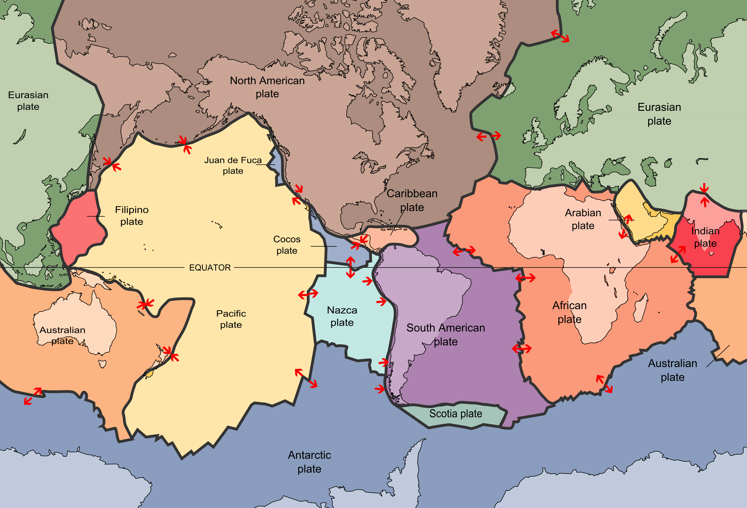
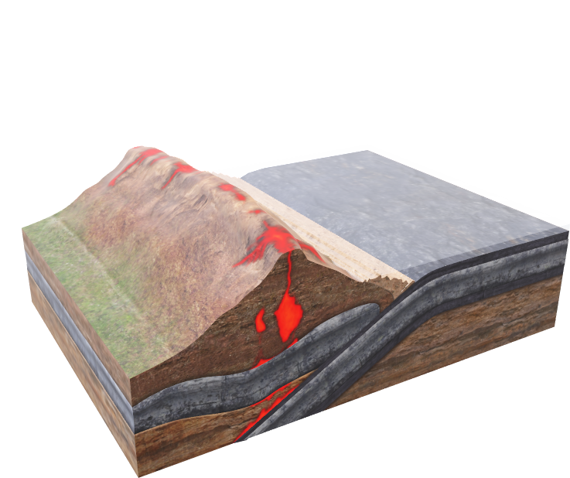
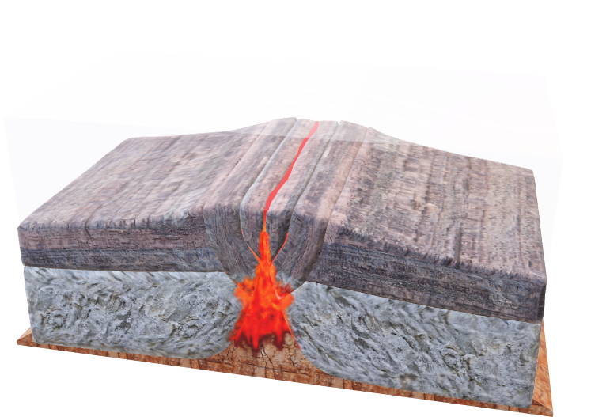
4. Plate tectonics
10
min
Note: for more activities related to this topic, see lesson plan “Plate tectonics” in our Lifeliqe app Creator.
All the Earth’s surface is covered by the lithosphere, which is divided into respective tectonic plates. These plates “float” above the asthenosphere and each one of them move in a certain direction. Show your students how the lithosphere is divided into the particular plates on the plate tectonics map!
Map: USGS Description: Scott Nash, Plates tect2 en, marked as public domain, more details on Wikimedia Commons
If the whole surface is covered by these tectonic plates and each of them moves in a certain direction, it is inevitable that in some places they will collide and in others they have to diverge, leaving space in between them. Have a look at our Lifeliqe Geology gallery and find models called “Convergent (Destructive) Boundary” and “Divergent (Constructive) Boundary”. First, explain the diﬀerence between the two types of tectonic plates and then, with the help of the models, what happens when they collide or diverge.
Click on the model to interact

Slide 6
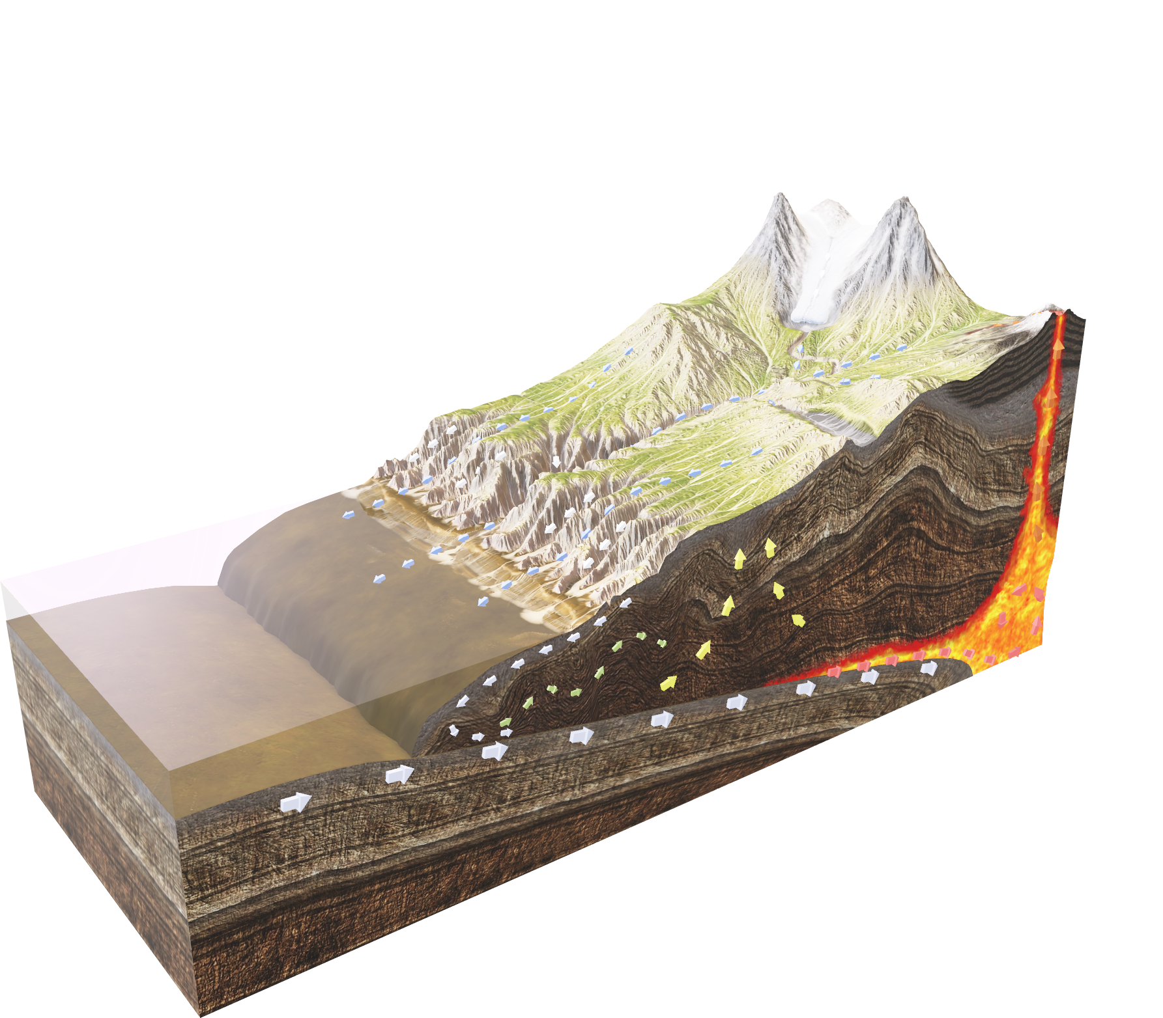
5. Cycling rocks
10
min
As the students need to know, the movement of tectonic plates leads in one case to the disappearing of part of the lithosphere (convergent boundary) and in other cases the creation of new ones. These movements are part of the so called rock cycle. Type “Rock Cycle” in the search field of the Lifeliqe app and open the model. Describe the circulation of rock and tell the students about their basic types.
Click on the model to interact

Slide 7
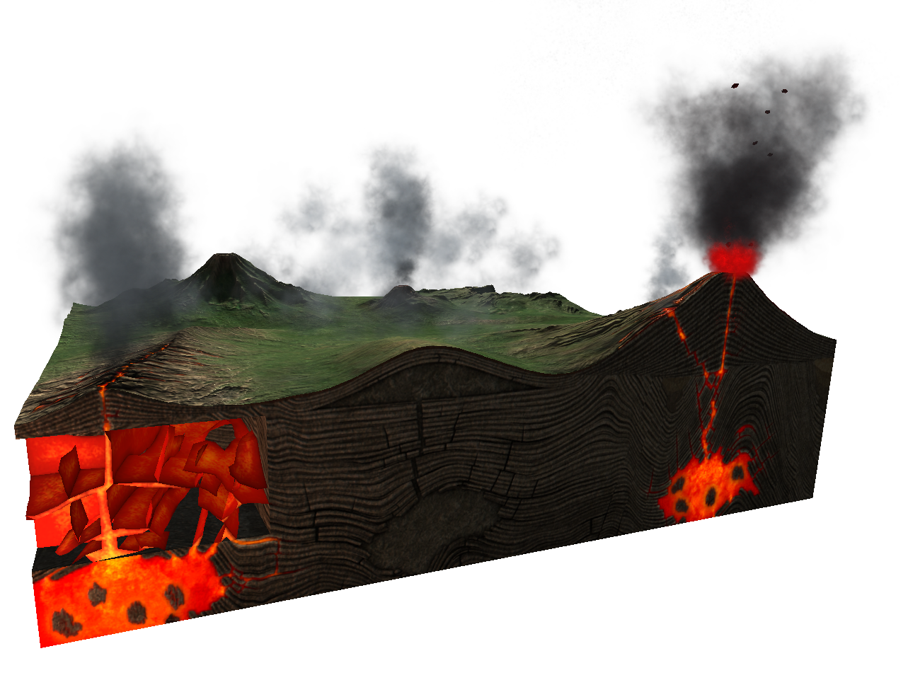
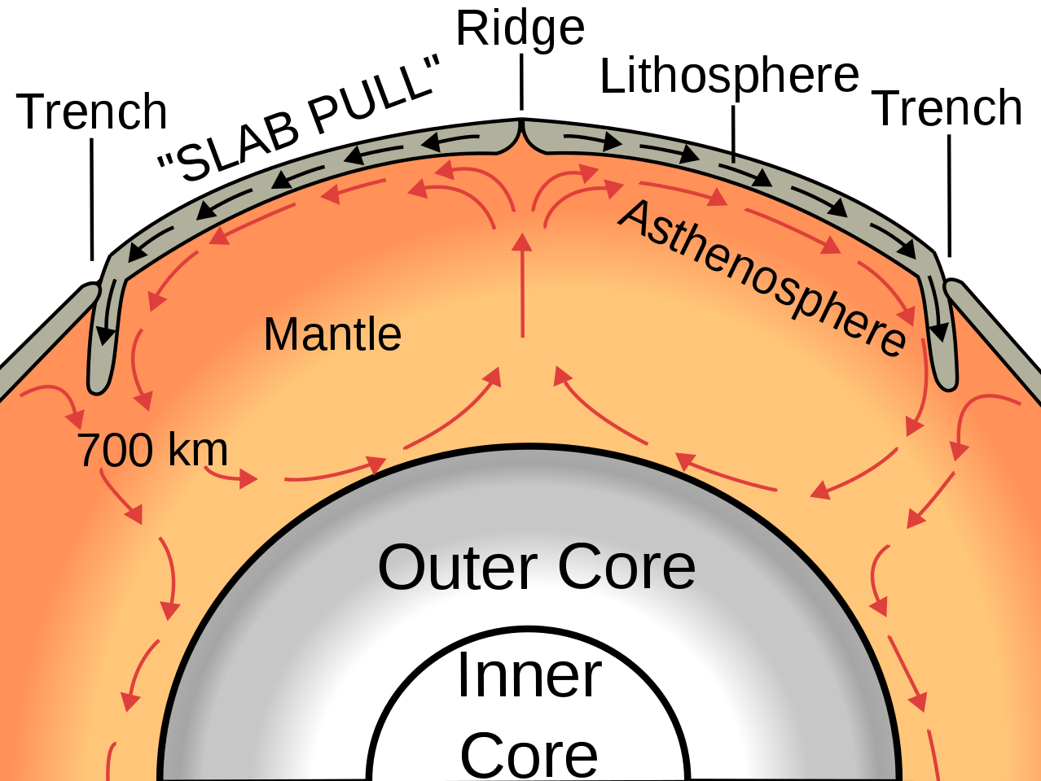
The old rock is driven back to the mantle, while new, melted rock comes from the Earth’s interior through a rift in the lithosphere. It can also come through volcanoes, a cone- shaped rupture, which also can release melted rock in the form of lava. You can find “Volcanic Activity” and “Stratovolcano (Composite Volcano)” models which describe it in the Geology gallery of the Lifeliqe app.
Click to open in Lifeliqe
The heating and melting of rock occurs in the Earth’s mantle. The old rock is being melted, then additional heat is added by the planet's core and the rock returns back to the surface, forming this way a circle. This circulatory motion of heated material is called thermal convection (in diﬀerence with thermal conduction, when just heat is transferred, not matter). This circulation also allows for tectonic plate movement.
Surachit (https://commons.wikimedia.org/wiki/File:Oceanic_spreading.svg), „Oceanic spreading“, https://creativecommons.org/licenses/by-sa/3.0/legalcode

Slide 8
6. Experiment – Circulating heat
15
min
In this experiment we will practically simulate the circulating movement of matter when it’s heated. This will help your students to understand how this circulation works beneath the Earth’s surface.
Tools: Laboratory glass container, Water, Colored ice cubes (you can prepare them before the experiment using food coloring), Food coloring (diﬀerent color than the one you used for colored ice cubes), Small beaker, Burner, Eye Dropper.
Instructions:
Fill the container with water. Place it on the working board in way that you will be able to place the burner below it (the container can be placed above some bases).
Pour some water in the beaker. Add the food coloring and heat the beaker.
Prepare the colored ice cubes. Throw some of them to the sides of the container and observe with the students how the cold colored water from the melting ice cubes flows downwards, to the bottom of the container.
Fill the dropper with hot colored water from the beaker. Add some drops to the center of the container. Observe again what happens and how the colored water moves.
To make the cycling faster, locate the burner below the center of the container and begin to heat it with a low flame. Have a look at how the cycling of water has fastened! If necessary, add some more drops of colored water to the center of the container, to make the circulation more visible.
7. Final wrap-up
10
min
To end the lesson, first wrap-up the key information from this lesson. Then discuss with the students the related topics:
Can the Earth’s interior heat be useful in any way? How?
Can we feel the tectonic movement? How/when?
How we can prevent the harm caused by the related eﬀects (earthquakes, volcanic activity)?
What is the place you live/study in from the geological point of view? Which plate is it? What happens with the plate? Are there any geological dangers?

Slide 9

Thanks for using Lifeliqe's lesson plan!
Excite your students in learning science with 1,000+ more 3D models and lesson plans at online.lifeliqe.com

